Slide 1
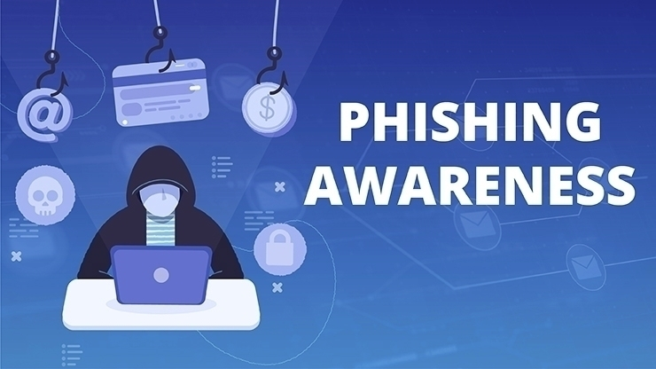

Slide 2
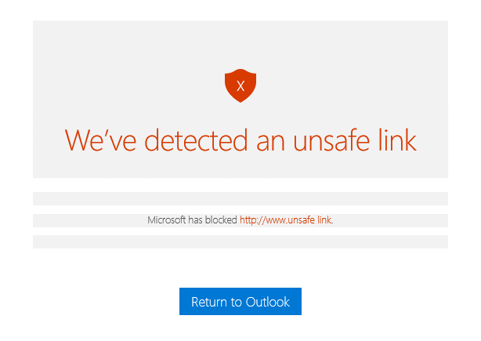
1. Avoid viruses and phishing scams
Phishing Awareness Training
With the growing presence and sophistication of online threats like viruses, ransomware, and phishing scams, it’s important to have the right protection. Microsoft gives you advanced security tools to help keep your information secure and private.
35%
Malware and viruses attack your computer when you visit malicious websites or download infected files. Thirty-five percent of all computers globally are infected by malware.
23%
Hackers use phishing scams to try to steal your identity or money by sending official-looking email asking for sensitive personal information. 23% of people open phishing email.
To stay safe, use Outlook.com to send and receive email. Outlook.com uses advanced detection techniques to check attachments for viruses, and it warns you if you click on a suspicious link.

Slide 3
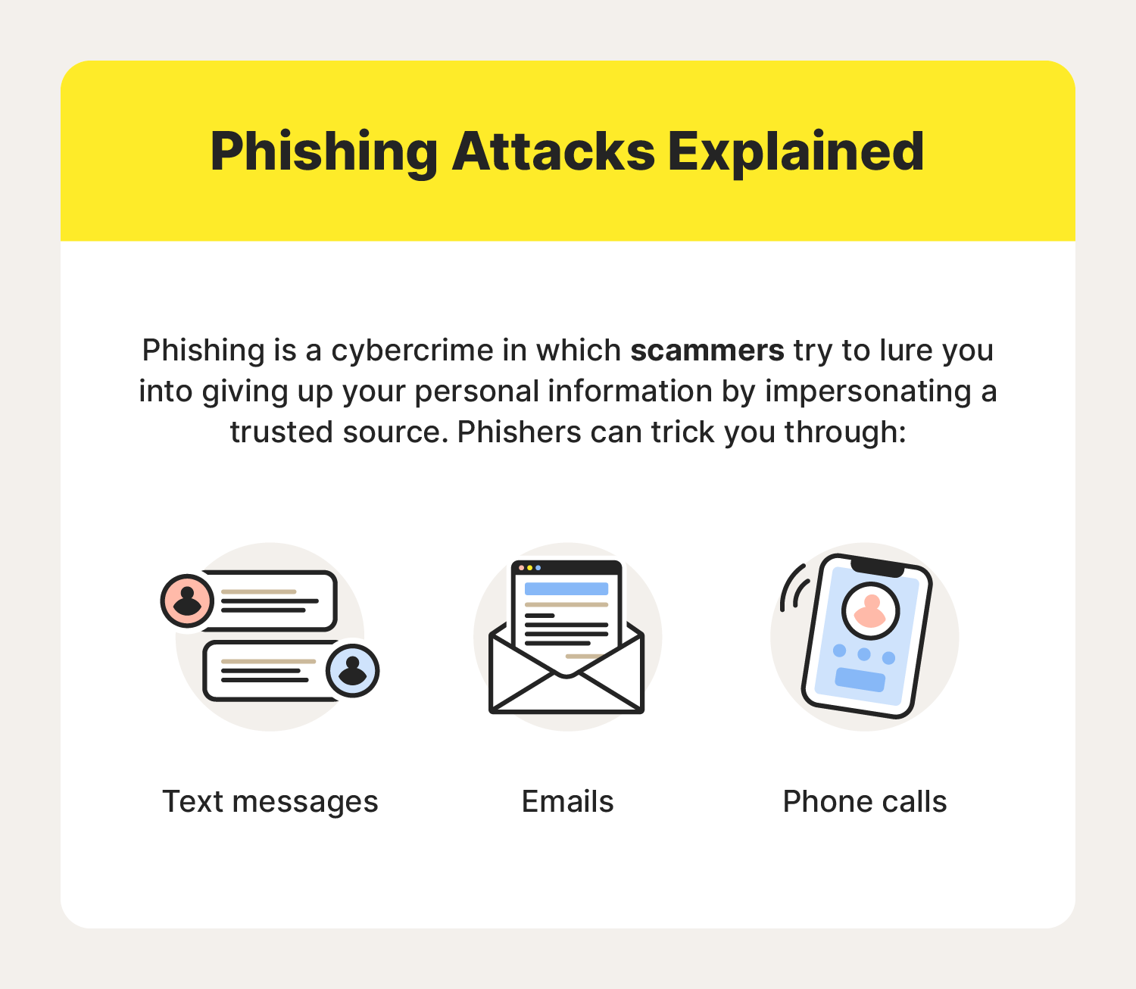
2. What is Phishing ?
Phishing is a social engineering cyberthreat where scammers impersonate a trustworthy source and trick you into revealing sensitive data like passwords, credit card numbers, or personally identifiable information.

Slide 4
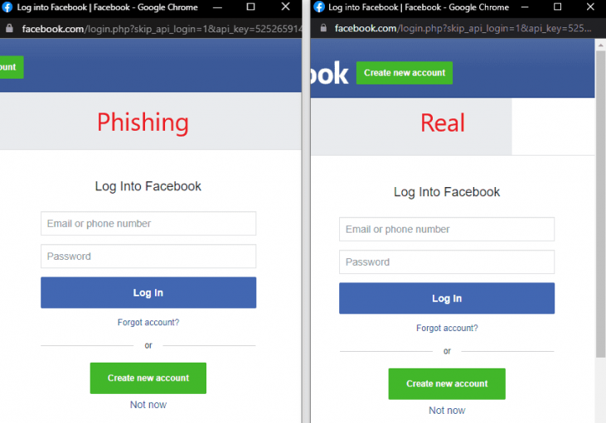
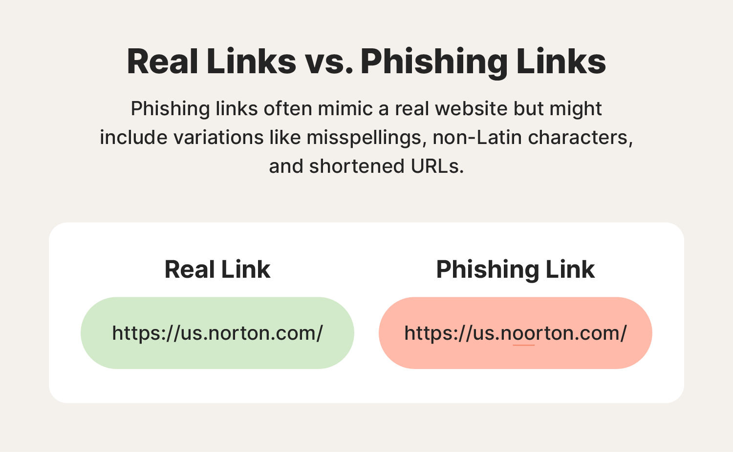
3. Recognize phishing emails and fake websites
Sending confidential or personal information online can be worrisome. Using OneDrive, you can require a password to access a shared link. This prevents others from accessing your files if the recipient forwards or shares the link.
For example, a phishing email might look like it's from your bank and request private information about your bank account. Phishing messages or content may: Ask for your personal or financial information. Ask you to click links or download software.

Slide 5
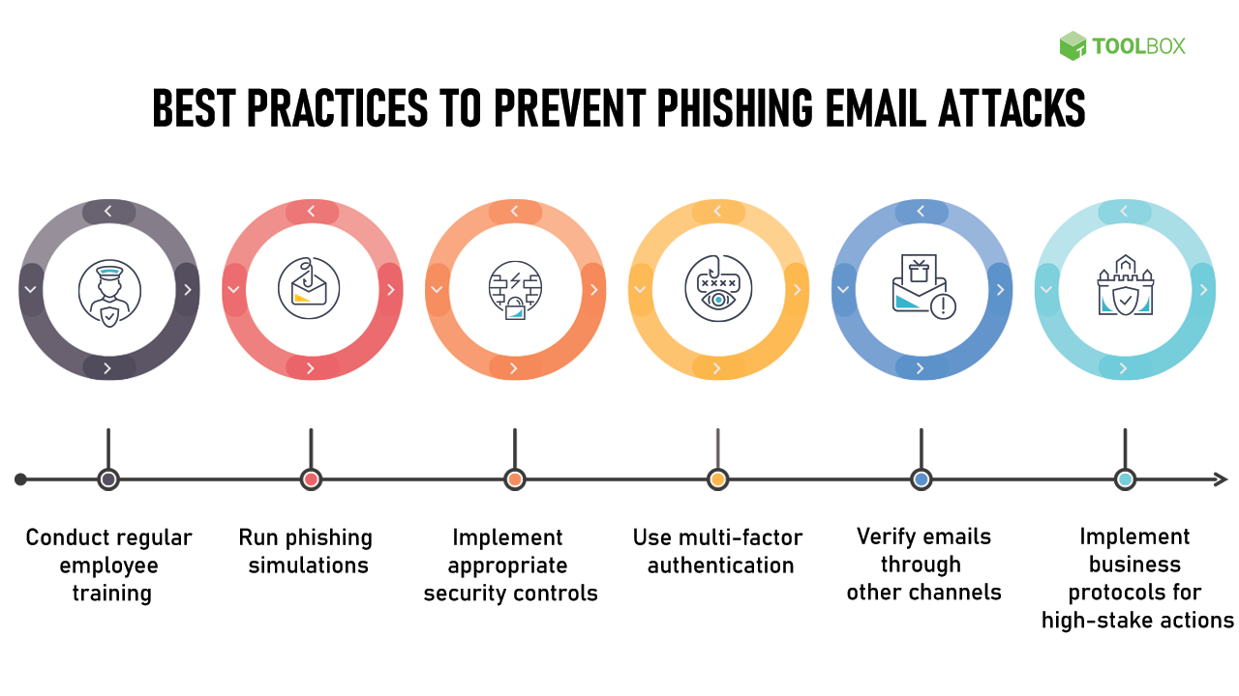
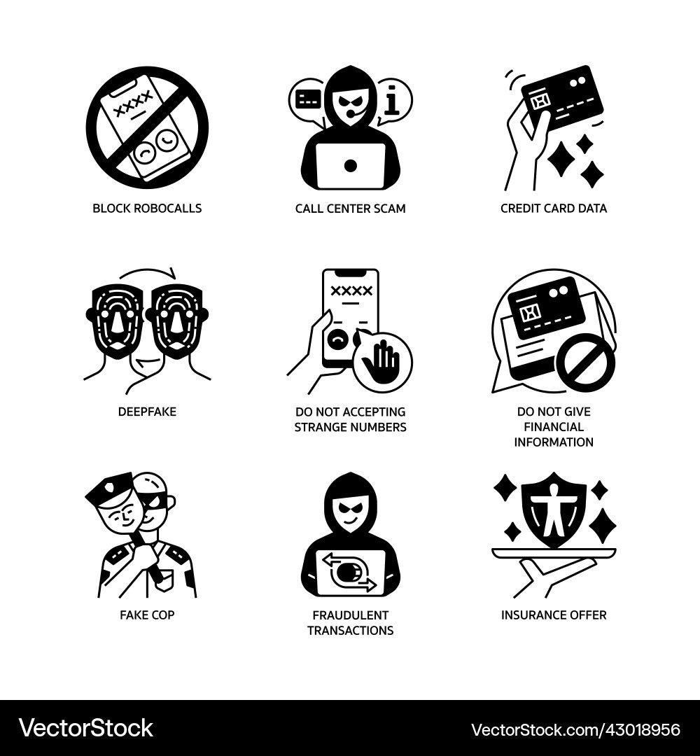
4. Best practices and tips to avoid falling as victim.
Never provide personal financial information, including your Social Security number, account numbers or passwords, over the phone or the Internet if you did not initiate the contact. Never click on the link provided in an email you believe is fraudulent.

Slide 6
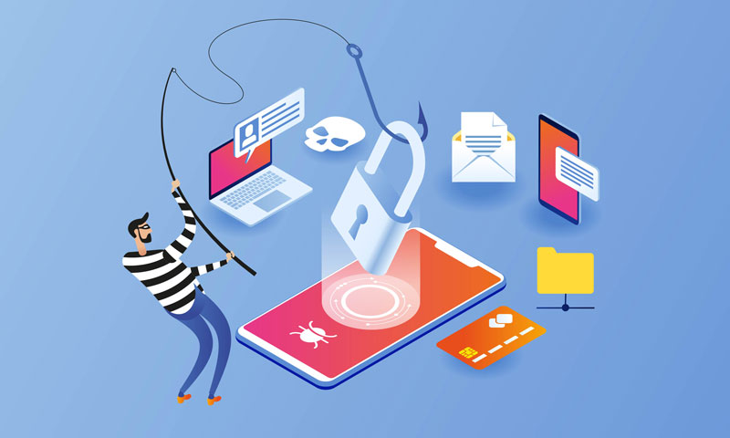
THANK YOU
Get Educated on phishing attacks

